Slide 1
Data & ai Power BI use case
Team members: Naomi Thiru Mikael Dominguez Christophe Schellinck

Slide 2

Analysis Question
Client: PROSPECTIVE BUSINESS OWNER
Questions
What are the successful businesses from the data presented?
How do the customer numbers compare per restaurant?
Is location an important factor?
What are the most popular order items?
What are the peak order hours?

Slide 3
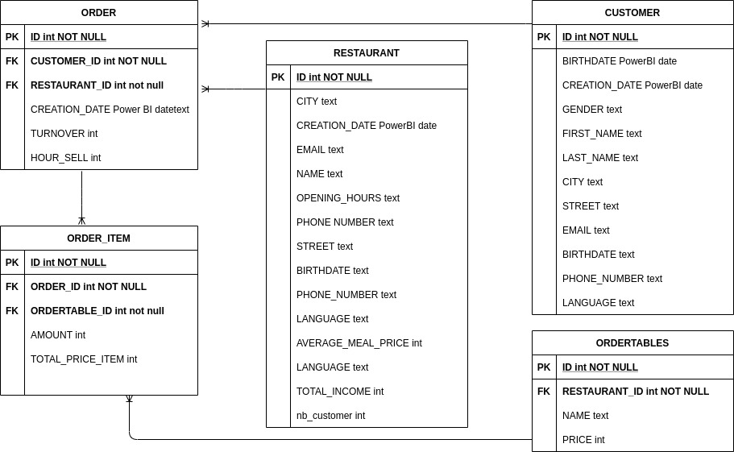
Data Model

Slide 4

Client Report

